Slide 1
Unsupervised Modeling of Twitter Conversations
By Alan Ritter, Colin Cherry and Bill Dolan
Presented By
Anirudh

Slide 2
1. INTRODUCTION Understanding Human Conversations
Automatic Detection of Dialogue Structure
Dialogue Acts annotates utterances with shallow discourse role (“Statement”, “Question”, “Answer”)
Used in Applications such as Conversational Agents, Dialogue Systems, Dialogue Summarization and Flirtation Detection.

Slide 3
DIALOGUE ACT APPROACH
ANNOTATE TRAIN-TEST
Design of Annotation guidelines
Collection and Labeling of Corpora
Train tagger to automatically recognize dialogue acts
DISADVANTAGES
Slow
Expensive

Slide 4
NEW APPROACH
UNSUPERVISED CONVERSATION MODELS
Discovery of acts amounts to clustering utterances with similar conversational roles.
Allows the learning algorithm to tell us something about how people converse in new medium.

Slide 5
UNSUPERVISED CONVERSATION MODELS
Woszczyna and Waibel (1994) proposed Hidden Markov Model for dialogue structure in meeting domain. (Model Dialogue state at word level)
Crook et al. (2009) use Dirichlet process mixture models to cluster utterances in to a flexible number of acts in a travel planning domain. (Did not examine sequential structure of Dialogue)

Slide 6
2.DATA
Corpus of 1.3 Million Conversation.
Twitter posts are restricted to 140 characters max.
Twitter API provides link from each reply to the post it is responding to, allowing accurate thread construction.
37% Posts on Twitter are conversational in nature.

Slide 7
DATA
Used Publicly Available API.
Retained posts that were in reply to some other post.
Removed Non-English Conversation using Filter.
Each Conversation contains 2 to 243 post.

Slide 8
CHALLENGES
Twitter’s noisy style makes processing Twitter text more difficult than other domains.
Posts are often highly ungrammatical and filled with spelling errors.
Ran Jclusters word clustering Algorithm and observed.
Correct | Used in Conversations
COMING | COMMING
YOUR | YUHR, YUR, UR,YHUR, YOUUR
ABOUT | ABT, BOU, ABOUR,ABUT,BOWT

Slide 9
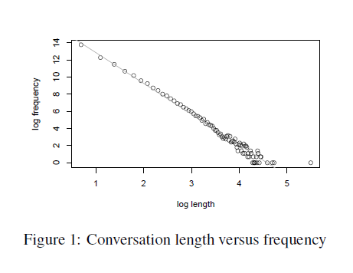
Conversation Length vs Frequency

Slide 10
3. DIALOGUE ANALYSIS
Two Models to Discover Dialogue acts in unsupervised manner
Conversation Model
Conversation + Topic Model

Slide 11
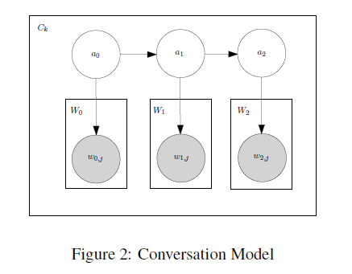
CONVERSATION MODEL
Each Conversation C is sequence of acts a.
Each act produces a post, represented by a bag of words W plates.
Number of acts available to the model is fixed
Experimented with between 5 and 40.
Trained using EM.

Slide 12
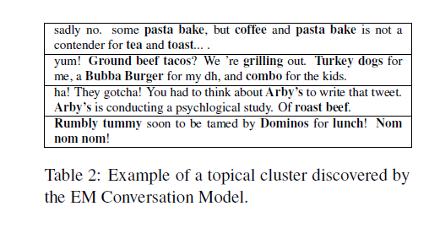
EM CONVERSATION MODEL

Slide 13
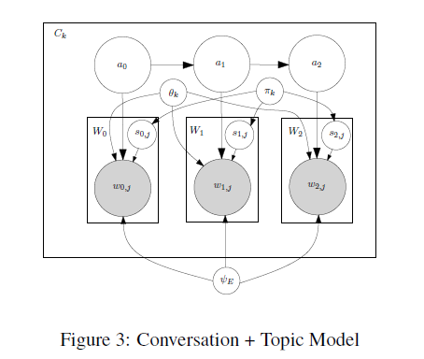
CONVERSATION + TOPIC MODEL
LDA (Latent Dirichlet Allocation) framework used for filtering out topic information.
Goal is to separate words from dialogue indicators.
Conversation specific word multinomial ϴk represents the topic.
ΨE represents Universal General English Multinomial.
S determines source of each word.
Πk is conversation specific distribution.

Slide 14

ESTIMATING LIKELIHOOD ON HELD-OUT DATA
Chibb estimators estimate the probability of unseen data , P(w) to selecting a high probability assignment to hidden variables h*.
P(w) can be easily calculated by conditional probability formula.
Murray and Salakhutdinov (2008) provide an unbiased estimator for P(h*|w) calculated using stationary distribution of the Gibbs sampler.

Slide 15
BAYESIAN CONVERSATION MODEL
Easier to Implement Bayesian Version of Model if Infrastructure necessary for Conversation + Topic Model Given.
Replaces emission and transitions probabilities with Dirichlet priors.
Replaces EM with Gibbs Sampling.
Improvements observed for Unsupervised part-of-speech tagging (Goldwater and Griffiths).

Slide 16
EXPERIMENTS
Trained our models on set of 10,000 randomly sampled conversations with length 3 to 6.
5000 most frequent words used as vocabulary in the corpus.
Train for 100 iterations, evaluating performance on each iteration on test set and report maximum when using EM.
Smoothing Parameters are set using grid search on a development set.

Slide 17
Contd..
Use 1000 samples for burn-in and take 10 samples at a lag of 100 when performing inference with Gibbs Sampling.
Taking multiple samples substantially improved performance during development.
Concentration parameters chosen in this manner were always sparse (< 1) producing moderate improvement over an uninformed prior.

Slide 18
QUALITATIVE EVALUATION
Conversation + Topic model easiest to interpret.
10- act model has 8 acts that we found intuitive while the other 2 are used with low probability.
Conversation model whether trained by EM or Gibbs sampling suffered from inclusion of general terms and from conflation of topic and dialogue.

Slide 19
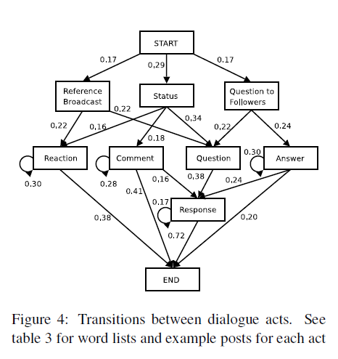
VISUALIZATION OF MATRIX OF TRANSISTION PROBABILITES BETWEEN DIALOGUE ACTS
An arrow drawn from one act to another if probability is greater than 0.15.
Status act gives information about what user is doing.
Reference Broadcast consists of URL and Usernames
Reaction is appreciation or excitement to information.
Question to Followers represents user asking question.
Question is response to initial post.

Slide 20
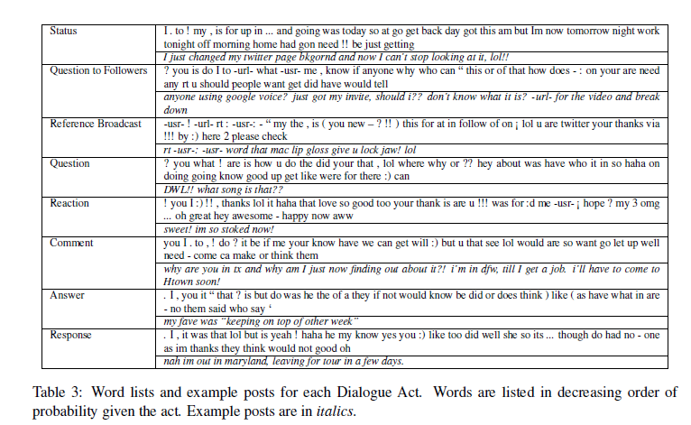
WORD LIST AND EXAMPLE POSTS FOR EACH DIALOGUE ACT

Slide 21
QUANTITATIVE EVALUATION
Measures model’s predictive power.
Test set consists of 1000 randomly selected conversations not found in the training data we generate n! permutations of the post.
Probability of each permutation is evaluated using either forward algorithm (EM) or Gibbs.

Slide 22

Contd..
We Employ Kendall’s τ to measure similarity of the max-probability permutation to the original order.
Where n+ is the number of pairs that share the same order in both permutations and n- is the number that do not.
Statistics ranges between -1 and +1, where -1 indicates inverse order and +1 indicates identical order.
A value greater than 0 indicates a positive correlation.

Slide 23
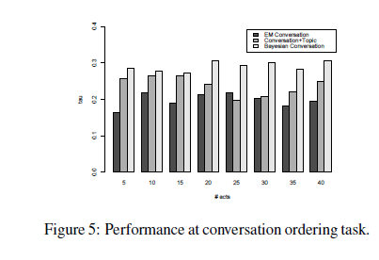
PERFORMANCE AT PREDICTING ORDER
Bayesian Inference outperforms EM.
Bayesian outperforms Conversation + Topic model.

Slide 24
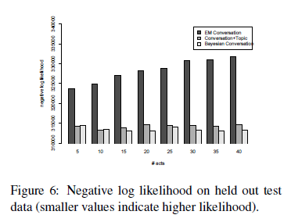
LIKELIHOOD
Bayesian Method produce model with Higher Likelihood.
Likelihood tends to decrease on test data as we increase the number of hidden states due to overfitting.

Slide 25
CONCLUSION
Presented an approach that allows the unsupervised induction of dialogue structure.
Extended conversation sequence model to separate topic and dialogue words, resulting in an interpretable set of automatically generated dialogue acts.
Reflected Twitter’s nature as micro-blog.
Compared Bayesian inference to EM and showing clear advantage of Bayesian.
Collected Corpus of 1.3 Million Twitter conversation which can be used for future.

